Slide 1
Software Requirement Engineering
Challenges of Requirement Elicitation
Muhammad Nasir
m.nasir@iiu.edu.pk

Slide 2
Agenda
The “Yes, But...” Syndrome
The "Undiscovered Ruins..." Syndrome
The "User and the Developer..." syndrome

Slide 3
Barriers in Requirement Elicitation
Requirement's elicitation is complicated by three syndromes.
The "Yes, But" syndrome stems from human nature and the users' inability to experience the software until it is released.
Searching for requirements is like searching for "Undiscovered Ruins"; the more you find, the more you know remain.
The "User and the Developer" syndrome reflects the profound differences between these two, making communication difficult.

Slide 4
The "Yes, But" Syndrome
One of the most frustrating problems in all of application development is what we have come to call the "Yes, But" syndrome.
We always see two immediate, distinct, and separate reactions when the users see the system implementation for the first time.

Slide 5
The "Yes, But" Syndrome
"Wow, this is cool; we can really use this, what a neat job" and so on.
"Yes, but, hmmm, now that I see it, what about this . . . ? Wouldn't it be nice if . . . ?
The users' reactions are simply human nature

Slide 6
The "Yes, But" Syndrome
The users haven't seen your new system or anything like it before; they didn't understand what you meant when you described it earlier and now that it's in front of them—
now, for the first time after months or years of waiting—
they have the opportunity to interact with the system.
And guess what: it's not exactly what they expected!

Slide 7
The "Yes, But" Syndrome
We can drastically reduce this syndrome by applying techniques that get the "Buts" out early.
In so doing, we elicit the "Yes, But" response early...
  Incremental software development
  Agile software development
  Prototyping

Slide 8
The "Undiscovered Ruins" Syndrome
Once a bus tour was sprawling ancient ruins...
The tour guide got a silliest question from a tourist, "So, hmmm, how many undiscovered ruins are there?"

Slide 9
The "Undiscovered Ruins" Syndrome
In many ways, the search for requirements is like a search for undiscovered ruins: the more you find, the more you know remains.
You never feel that you have found all the requirements
Software Development teams always struggle to determine when they found all the requirements or at least enough requirements.

Slide 10
The "Undiscovered Ruins" Syndrome
However, as with finding all the undiscovered ruins, we must acknowledge that we are on a mission that can never be completed.
But we also understand that at some point we will be able to say with confidence, "We have discovered enough for now; we'll find the rest later."

Slide 11
The "User and the Developer" Syndrome
Techniques for requirements elicitation are not new.
Application developers have strived since several decades to do a better job.
What could possibly account for the fact that understanding user needs remains one of our largest problems?

Slide 12
The "User and the Developer" Syndrome
Well, considering the fact that few application developers have any training in any elicitation techniques, it's perhaps not quite surprising.

Slide 13
The "User and the Developer" Syndrome
The “User and the Developer” syndrome arises from the communication gap between the user and the developer.
Users and developers are typically from different worlds, may even speak different languages, and have different backgrounds.

Slide 14
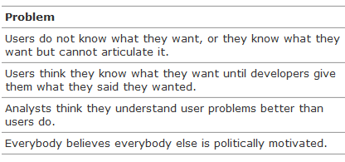
The "User and the Developer" Syndrome

Slide 15
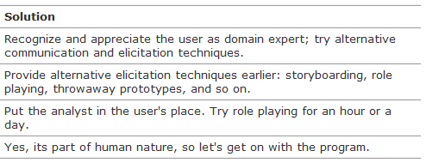
The "User and the Developer" Syndrome

Slide 16
The End
Thanks for listening
Questions would be appreciated.

